Slide 1
Project 1 - Group 2 (Economics)
Creators: Cole O, Joel F, Justin C, Selena P, & Zack W

Slide 2
Group 2 (Economics)
Objective:
This project aims to investigate the relationships and impacts associated with inflation and unemployment rates utilizing the Federal Reserve Economic Data (FRED). The analysis will be conducted using Pandas and Jupyter Notebook, with data visualization performed using Matplotlib.
Five-Year Analysis:
Conducting a comprehensive five-year analysis, categorizing the data into pre-COVID, during, and post-COVID periods (2017-2023). This timeline will provide insights into how economic indicators such as inflation and unemployment have evolved over these crucial phases.

Slide 3
Group 2 (Economics) - Questions
Is there a relationship between inflation and unemployment?
Is there a relationship between CPI (Consumer Price Index) and Nationwide Inflation Rate?
Summary of unemployment impact on a national and state basis (Michigan, California, Texas, New Jersey).

Slide 4
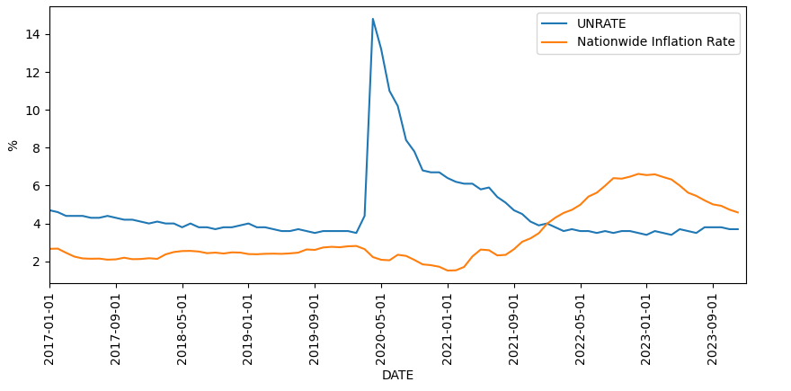
Is there a relationship between inflation and unemployment?

Slide 5
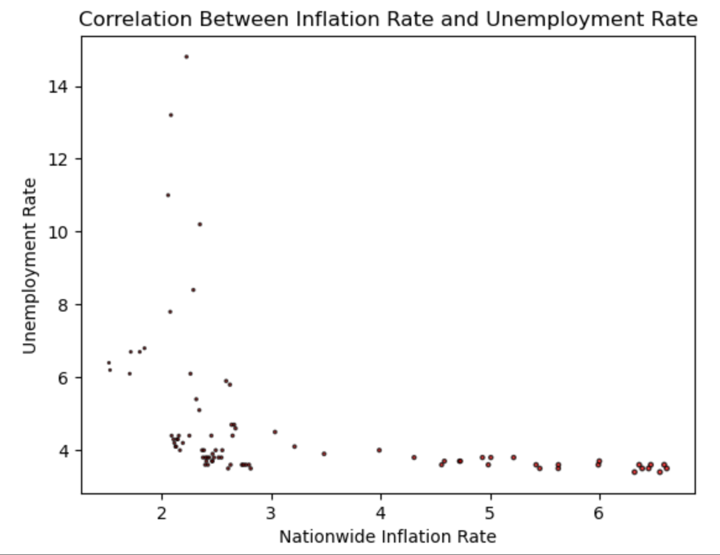
Is there a relationship between inflation and unemployment?
Analysis:
The inflation rate and unemployment rate were steady prior to covid and showed an inverse relationship during covid.
As nationwide inflation rate increases the unemployment rate decreases.

Slide 6
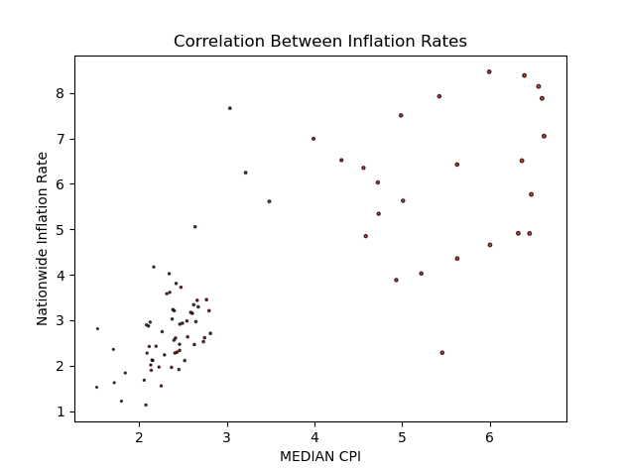
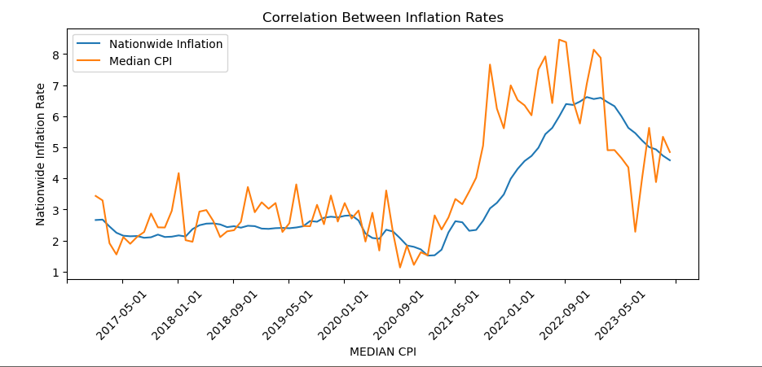

2. Is there a relationship between CPI and Nationwide Inflation Rate?
Analysis:
As median CPI increases, nationwide inflation rate also increases.
There is a strong correlation between the Nationwide Inflation Rate and the Median CPI (r=.79)

Slide 7
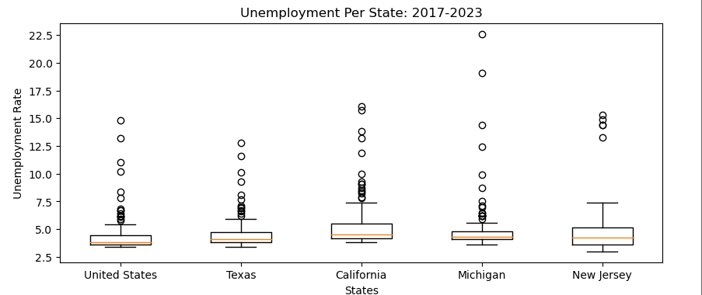

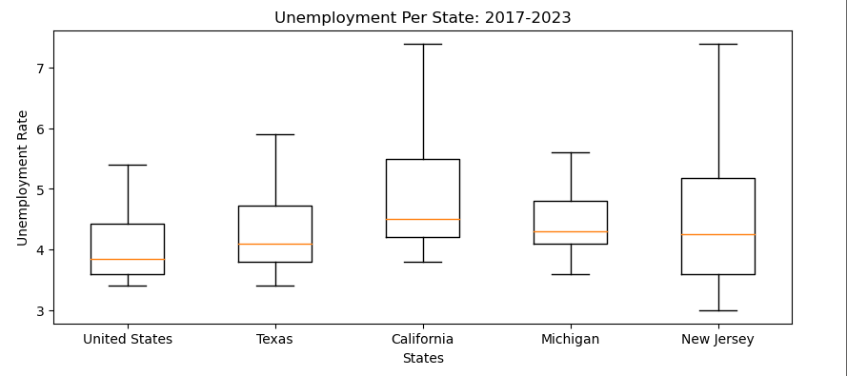
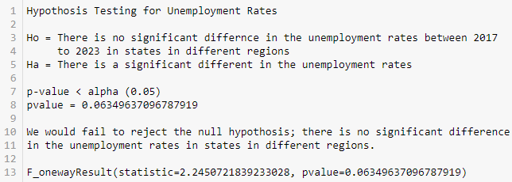

Analysis: -If we include all five data points in our analysis (Four states, One Nationwide) we would fail to reject our hypothesis. -When we drop the Nationwide data our P-value spiked up to .137.
3. Summary of unemployment impacts on a national and state basis (Michigan, California, Texas, New Jersey)

Slide 8
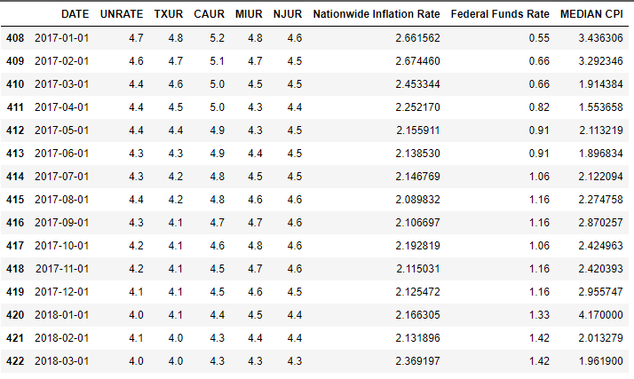
Data Frames (DF)

Slide 9

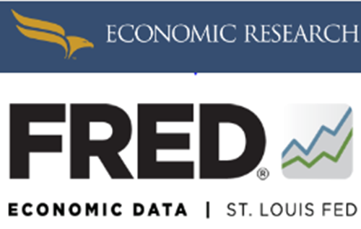



Sources

Slide 10
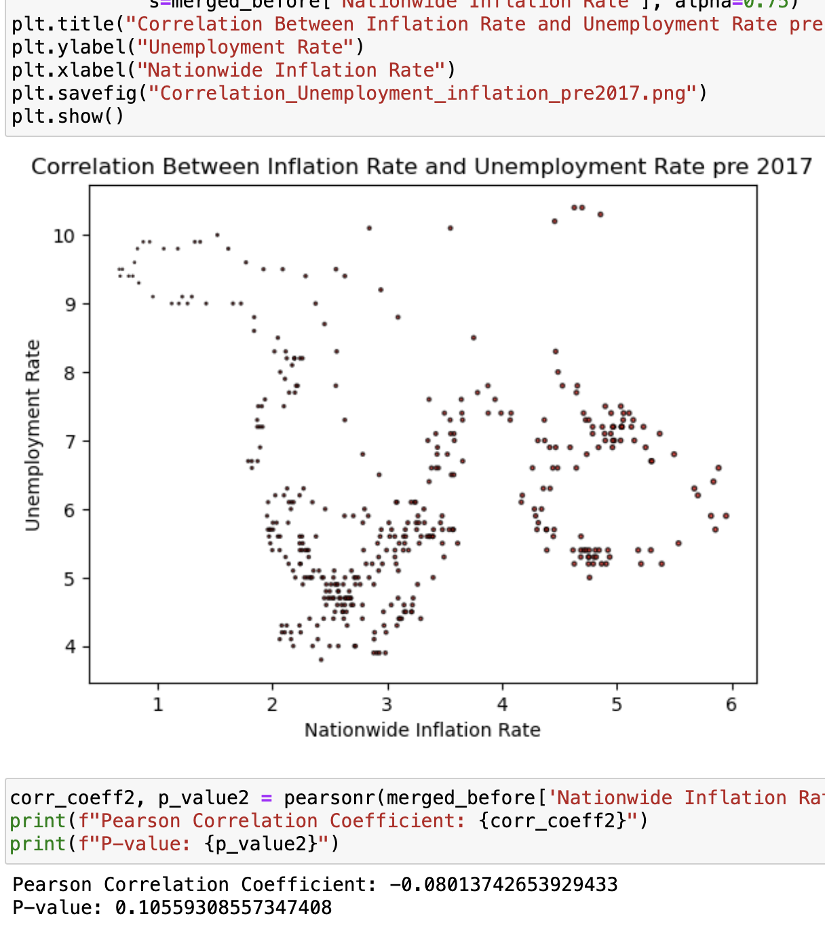
What's Next?!
Deeper analysis of the data we already have - regression etc., or a longer time-period to assess past recessions.
Finding other data sources.
Finding other variables to test if there is a stronger impact on unemployment/inflation...automation, demand, productivity, wages, etc.
Drop the outliers, rerun analysis on the unemployment.

